Slide 1
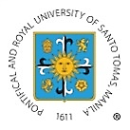
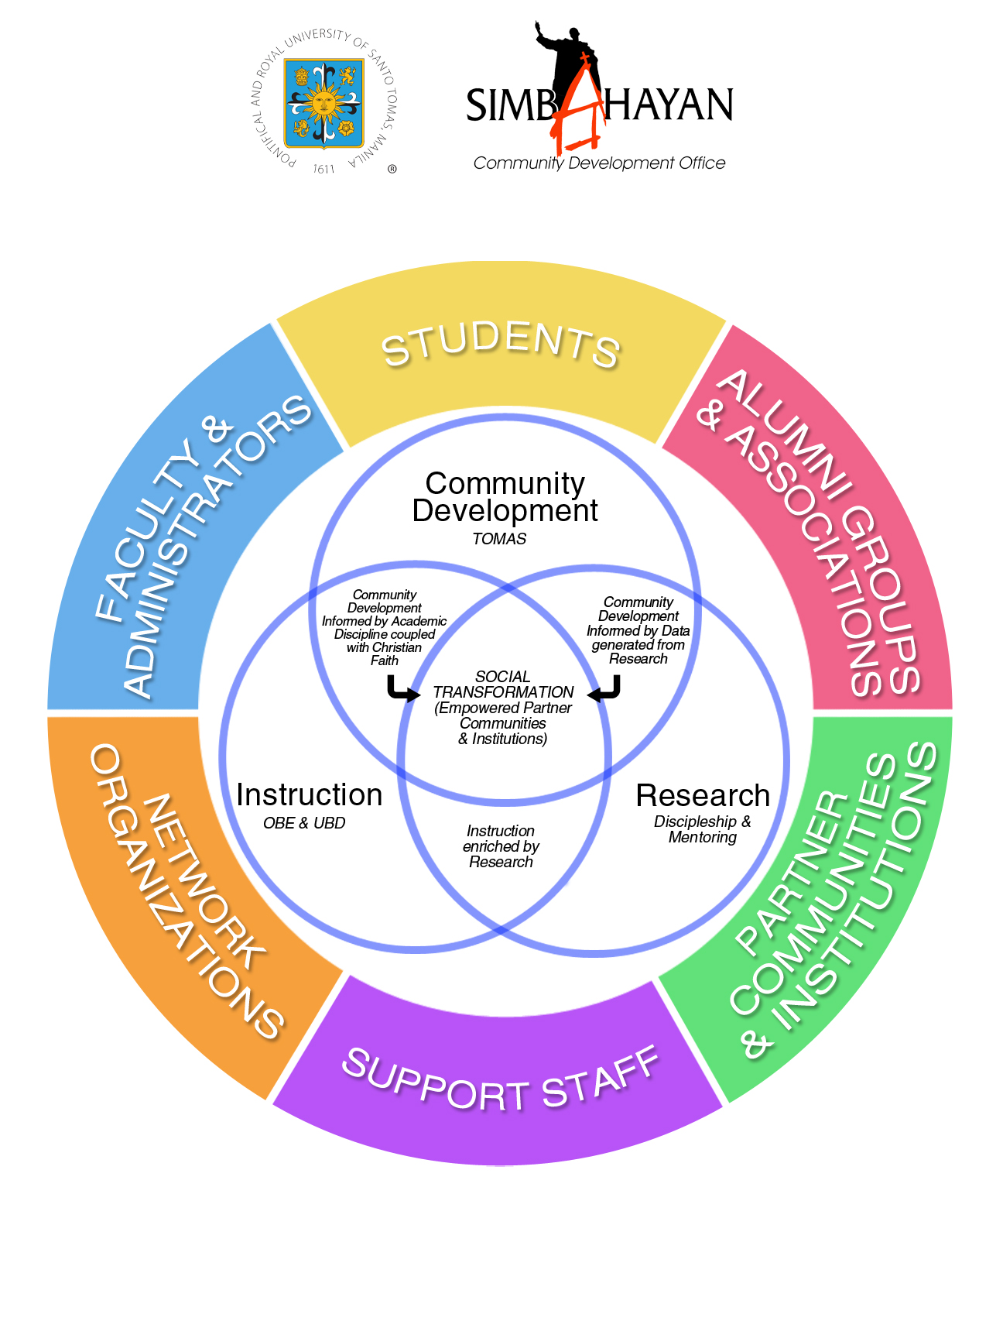
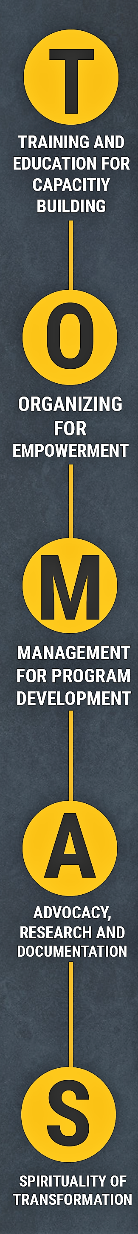
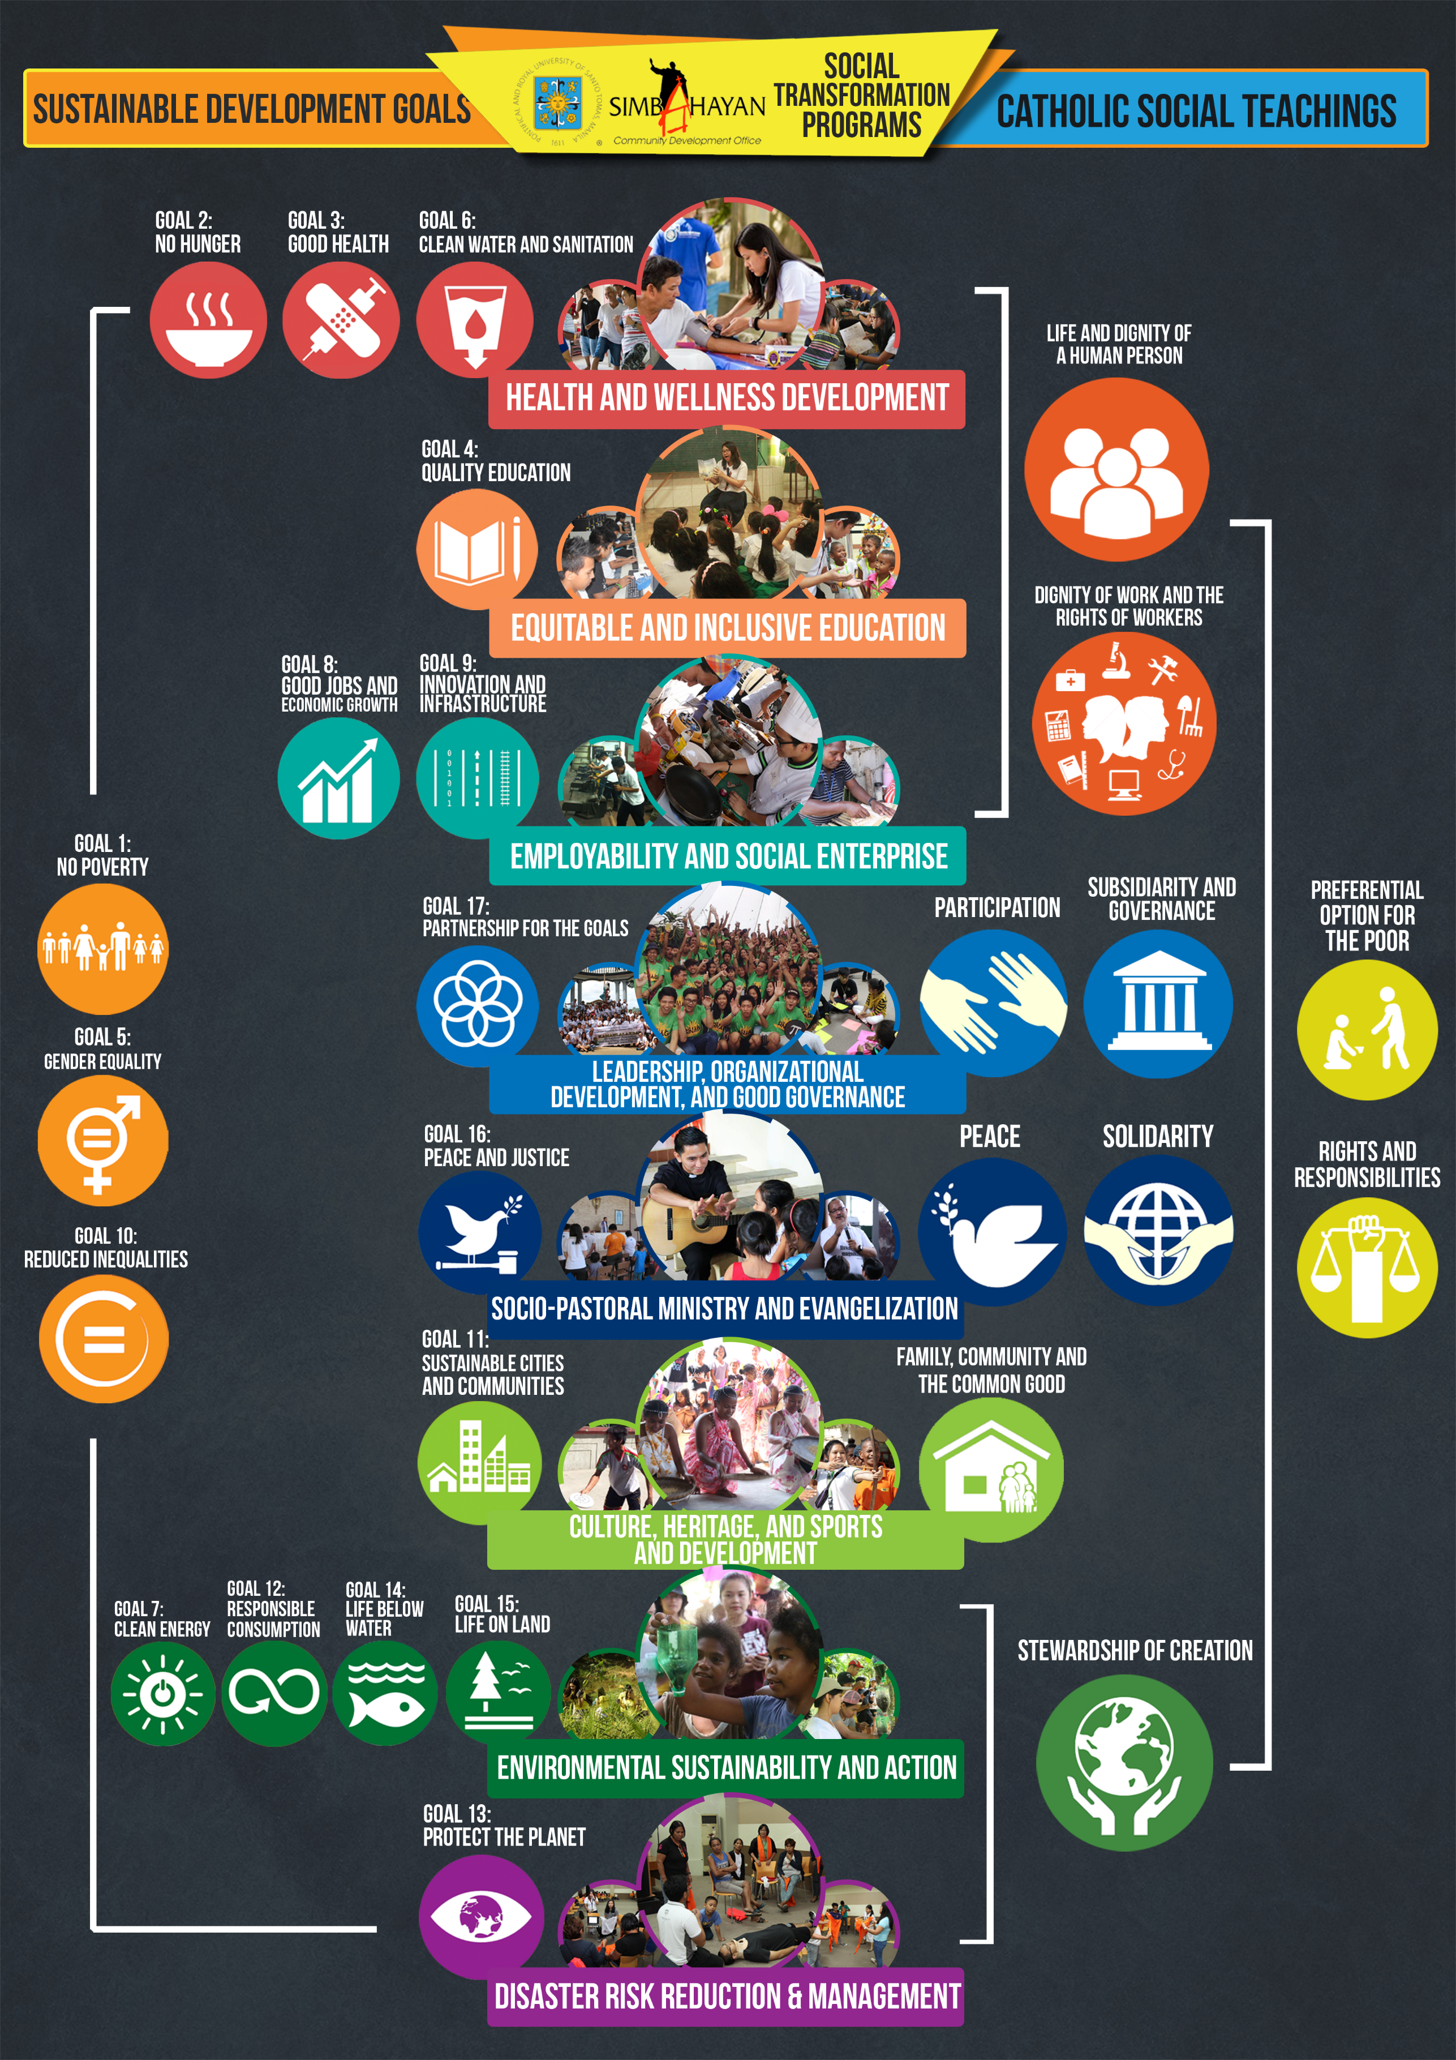
Tomasino para sa Simbahan, Tahanan at Bayan:
Thomasians Engaged in Social Transformation through Community Development
AUN-QA Criterion 4: Teaching and Learning
OUR MISSION
Generation, advancement, and transmission of knowledge to form competent and compassionate professionals, committed to the service of the Church, the nation, and the global community.
OUR FRAMEWORK
UST harnesses its three pillars of instruction, research and community development into one cohesive Social Transformation Framework, where:
Instruction is enriched by research;
Community development interventions are aligned to academic expertise illumined by Christian faith, demonstrating practical implementation of Gospel-centered service, truth and love;
Research provides needed data for evidenced-based planning, implementation, monitoring, and evaluation of community development programs and services.
Stakeholders act as agents of social transformation, collectively empowering partner grassroots communities and institutions towards improving the well-being of people who are marginalized, vulnerable, and excluded.
OUR PROGRAMS
The framework is translated into eight Social Transformation Programs which are aligned with the Sustainable Development Goals, as well as Catechism of the Catholic Church.
The description, goals, coverage, and success indicators of each program area are defined and disseminated to all stakeholders for better understanding of how they can contribute. Academic units are assigned to Program Areas aligned with their expertise. Areas for research are identified to address knowledge gaps and ensure that interventions respond to the needs of partner communities and institutions.
OUR STRATEGIES
The University makes use of the “TOMAS” approach as key strategies. The eight social transformation programs are sustainable for as they can be transferred and owned by the University’s partner grassroots communities and institutions.

